Slide 1
Pre-processing

Slide 2
What we will look at
Review workflow...
We will look at:
Feature selection
Feature transformation

Slide 3
Feature Selection
Ideally, we want to use a minimal number of maximally informative features, since more features lead to more:
noise.
parameters and overfitting.
computational load
But we want to keep useful and important features! So... How to choose the best features to use?
Background/expert knowledge
Pairwise statistical analysis
Model validation

Slide 4
Pearson´s Product Moment Correlation Coefficient
Both variables must be continuous.
Measures the linear correlation between two variables X and Y.
Gives a value between +1 and −1 inclusive, where 1 is total positive correlation, 0 is no correlation, and −1 is total negative correlation.
Linear, but non-linear correlation can be examined via transformations.
Implemented in stats package, cor.test function.

Slide 5
Mutual Information
Measures the information that X and Y share: how much does knowledge of one of these variables reduces uncertainty about the other.
Higher is better.
From 0 (if independent) to the entropy of the variables (if they are deterministic given the other).
So not from 0 to 1.
For discrete variables, this is implemented in the package entropy and function mi.plugin.
Continuous variables can be discretized.

Slide 6
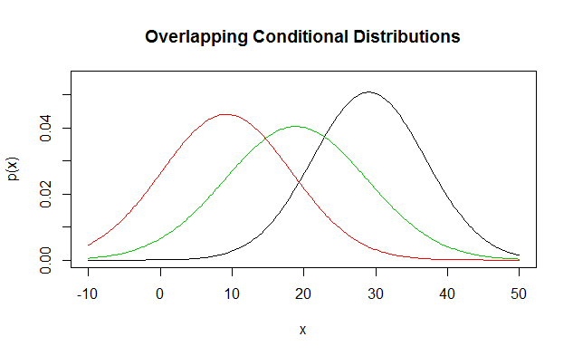
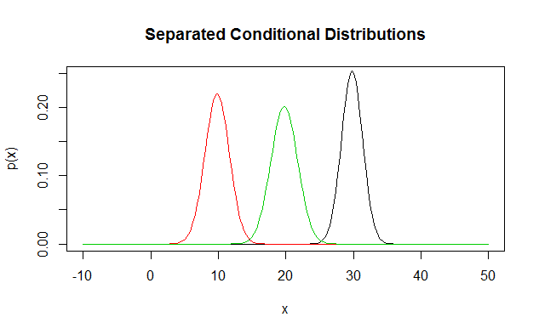
Conditional Distribution Divergence
Target Discrete – Feature Continuous or vice versa.
Consider the conditional distributions of the continuous variable given the discrete variable.
The greater the divergence, the more information the feature gives about the target.
Consider: Estimate class if x=20 on graphs to side.

Slide 7



Bhattacharyya distance
A distance measure between two distributions.

Slide 8
CDD using Bhattacharyya distance
Divide data by discrete classes
Calculate mean and variance of continuous variable for each set: m1,m2, … , mn; v1,v2,…,vn.
Assume conditional distributions normal (hence completely parameterized by mean and variance).
For each pair of distributions, i and j, calculate Bhattacharyya distance from first to second: mahij = bhattacharyya.dist(mi,mj,vi,vj)
Score is (weighted by numbers of cases, if desired) average distance between each pair of conditional distributions.

Slide 9
Feature Selection Exercises
Using the Duncan dataset in the car package. Assume prestige is the target variable and the other variables are input features.
Score the numeric features using correlation.
Bin the numeric features into 4 bins (1-25,26-50,51-75 and 76-100), then use Bhattacharyya distance to score all features.
Bin the target variable in the same way and use mutual information to score all features.

Slide 10
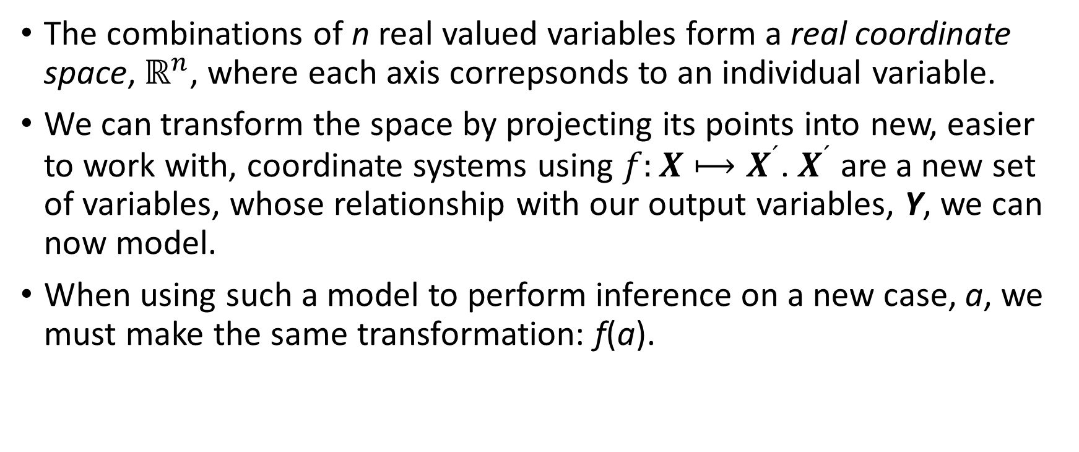
Transforming Feature Vectors
The combinations of n real valued variables form a real coordinate space, $ℝ^{n}$, where each axis correpsonds to an individual variable.
We can transform the space by projecting its points into new, easier to work with, coordinate systems using $f:X⟼X^{´}$. $X^{´}$ are a new set of variables, whose relationship with our output variables, Y, we can now model.
When using such a model to perform inference on a new case, a, we must make the same transformation: f(a).

Slide 11
Some Transformations
We saw transformations in polynomial regression, Poisson regression, and neural networks. These were part of the learning algorithm, and in the case of neural networks were adaptive.
Here we consider some pre-processing transformations:
Centering and scaling
PCA
PCA is an example of dimensionality reduction.

Slide 12
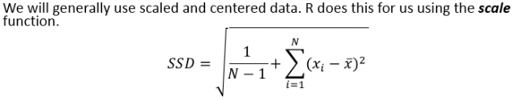
Centering and Scaling Variables
It is often useful to center and scale variables.
To center variables, we subtract their means.
To scale variables, we divide by their SSD.

Slide 13
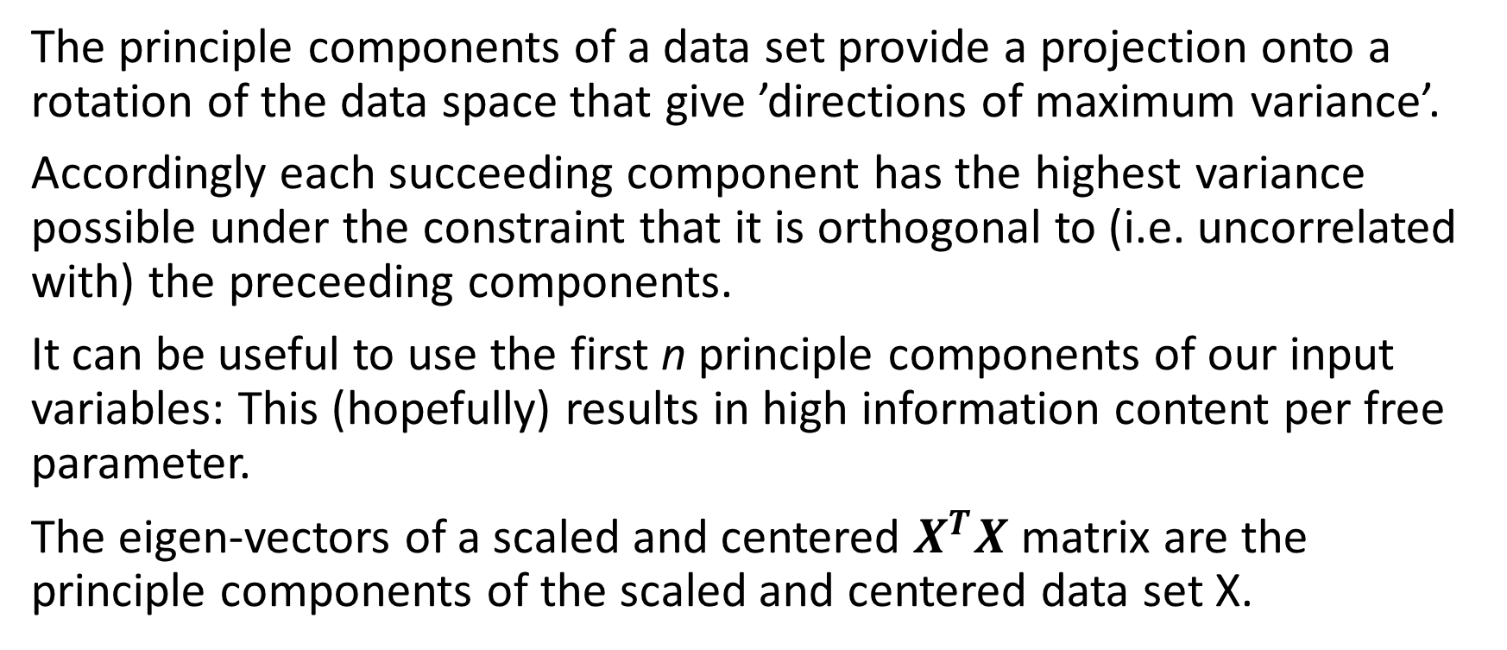
Principle Component Analysis
The principle components of a data set provide a projection onto a rotation of the data space that give ’directions of maximum variance’.
Accordingly each succeeding component has the highest variance possible under the constraint that it is orthogonal to (i.e. uncorrelated with) the preceeding components.
It can be useful to use the first n principle components of our input variables: This (hopefully) results in high information content per free parameter.
The eigen-vectors of a scaled and centered $X^{T}X$ matrix are the principle components of the scaled and centered data set X.

Slide 14
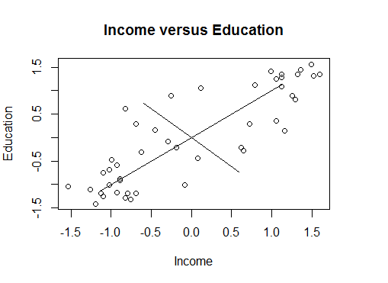
Principle Component Analysis Exercises
Get the principle components of the income and education variables in the Duncan data set.
Use R function prcomp.

Slide 15
General Basis Projections
This is the tip of the iceberg.
When regressing on X we can choose different coordinate systems (bases) formed from arbitrary functions of X.
Many advanced machine learning techniques utilize basis projections to find optimal coordinate systems within which to discover patterns within the data.

Slide 16
Feature Transformation Exercises
For the car::Duncan dataset:
Using prcomp and cv.glm (boots package), perform OLS and all but one cross-validation on:
Prestige vs Income and Education
Prestige vs Income
Prestige vs Education
Prestige vs both principle components of Income and Education
Prestige vs the first principle component of Income and Education
Discuss the results.

